Slide 1
dsDNA Virus Variant Analysis

Slide 2

Team
Elena Maria Cornejo Castro
Eneida Hatcher
Sara Jones
Sasha Mushegian
Yunfan Fan
Rashmi Naidu

Slide 3
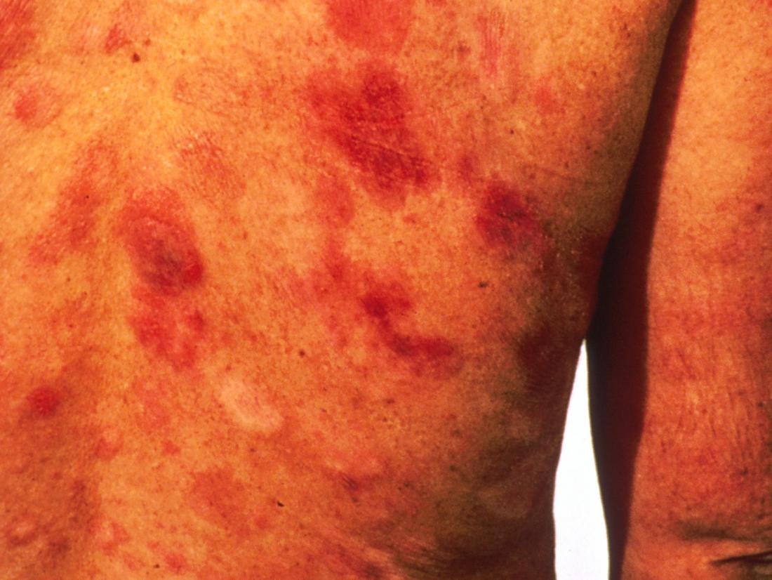
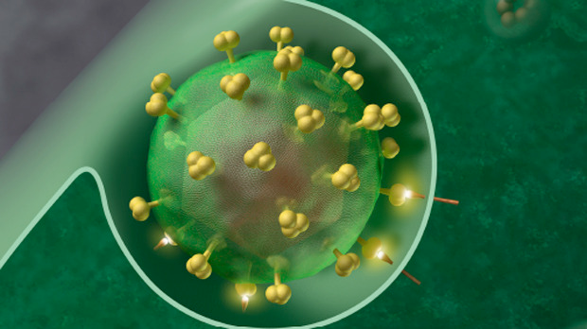
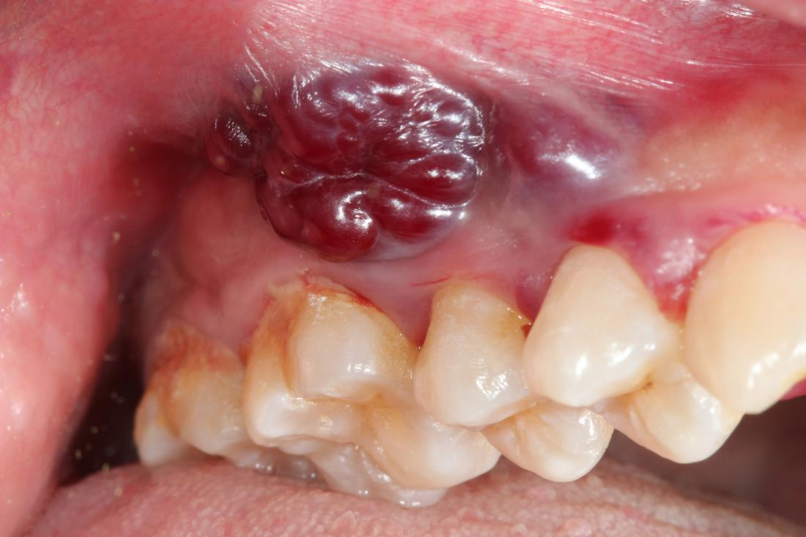


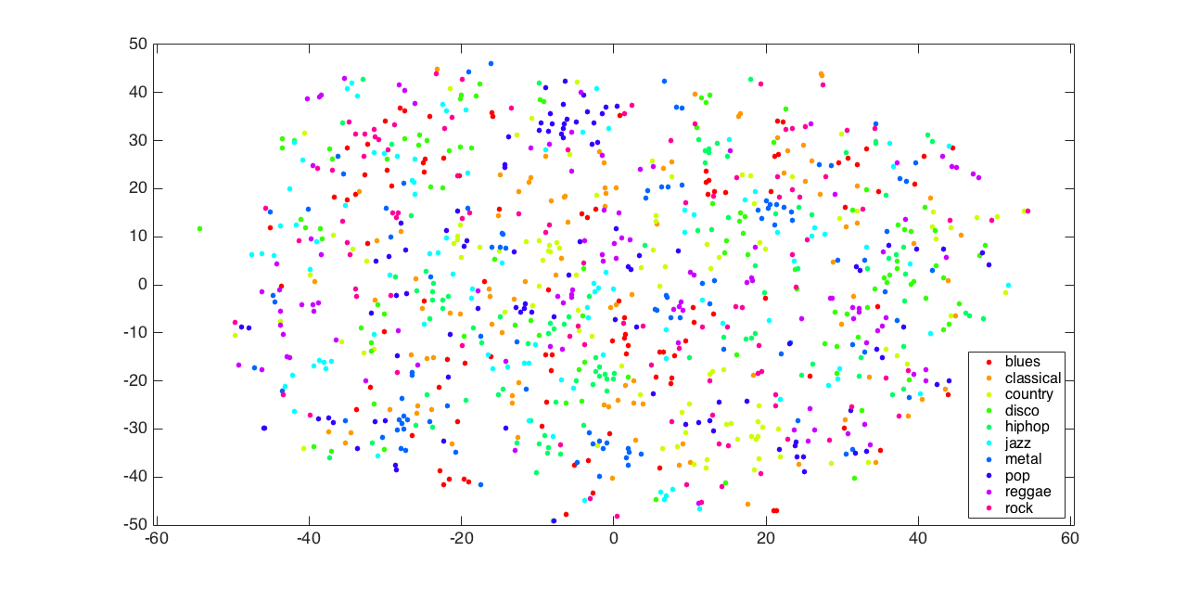
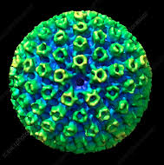
Why Gammaherpesviruses?
Large genomes make analyses more difficult
Worldwide distribution, but genomic associations with pathogenicity have not been determined
Sparse dataset makes drawing conclusions tricky
Viruses contain human sequence, and human genomes contain virus sequence

Slide 4
Input: paired end reads in FASTQ format
Denovo align reads into contigs = Mummer, Velvet, or Spades
Align contigs to reference = Mummer, Velvet, or Spades
Align reads to consensus of contigs
QC = Trimmomatic + FASTQC
Trim adaptors
Read-length trim
Trim reads that do not have sufficient sequencing depth
DeDupe to reduce duplicates
Remove human sequences
In Parallel
Reference-based alignment of short reads = BWA-MEM, Bowtie

Slide 5
Output consensus and variants relative to reference
Merge consensus
Call SNPs = GATK
Stretch Goal
Align public sequences to identify SNPs characteristic of subtypes
In addition to producing list of variants, provide most likely subtype

Slide 6
Goal: produce a consensus sequence from KSV sequencing short reads, and a list of the variants compared to a reference

Slide 7
Input: paired end reads in FASTQ format
QC = Trimmomatic + FASTQC
Trim adaptors
Read-length trim
Trim reads that do not have sufficient sequencing depth
DeDupe to reduce duplicates
Remove human sequences
Denovo align reads into contigs = BWMEM, Bowtie
Align contigs to reference = Mummer, Velvet, or Spades
References are usually partial, or do not encompass the variation seen in the sample
Align reads to consensus of contigs
In Parallel
Reference-based alignment of short reads
SNP caller GATK

